Slide 1
Institutional Framework under the DM Act

Slide 2
NATIONAL DISASTER MANAGEMENT POLICY Vision
To build a safe and disaster resilient India by developing a holistic, proactive, multi-disaster oriented and technology driven strategy through a culture of prevention, mitigation, preparedness and response.

Slide 3
Disaster Management
A disaster refers to a catastrophe, mishap, calamity or grave occurrence from natural or man-made causes, which is beyond the coping capacity of the affected community. DM involves a continuous and integrated process of planning, organising, coordinating and implementing measures which are necessary or expedient for:
­Prevention of danger or threat of any disaster.
­Mitigation or reduction of risk of any disaster or its severity or consequences.
­Capacity building including research and knowledge management.
­Preparedness to deal with any disaster.

Slide 4
­Prompt response to any threatening disaster situation or disaster.
­Assessing the severity or magnitude of effects of any disaster.
Evacuation, rescue and relief.
­Rehabilitation and reconstruction.

Slide 5
A typical DM continuum comprises six elements; the pre-disaster phase includes prevention, mitigation and preparedness, while the postdisaster phase includes response, rehabilitation, reconstruction and recovery.

Slide 6
Approach
A holistic and integrated approach will be evolved toward disaster management with emphasis on building strategic partnerships at various levels. The themes underpinning the policy are:
Community based DM, including last mile integration of the policy, plans and execution.
Capacity development in all spheres.
Consolidation of past initiatives and best practices.
Cooperation with agencies at national and international levels.
Multi-sectoral synergy.

Slide 7
The objectives of the national policy on disaster management
Promoting a culture of prevention, preparedness and resilience at all levels through knowledge, innovation and education.
Encouraging mitigation measures based on technology, traditional wisdom and environmental sustainability.
­ Mainstreaming disaster management into the developmental planning process.
­Establishing institutional and techno-legal frame works to create an enabling regulatory environment and a compliance regime.

Slide 8
Ensuring efficient mechanism for identification, assessment and monitoring of disaster risks.
­Developing contemporary forecasting and early warning systems backed by responsive and failsafe communication with information technology support.
­Promoting a productive partnership with the media to create awareness and contributing towards capacity development.
­Ensuring efficient response and relief with a caring approach towards the needs of the vulnerable sections of the society.
­Undertaking reconstruction as an opportunity to build disaster resilient structures and habitat for ensuring safer living.
­Promoting productive and proactive partnership with media in disaster management.

Slide 9
Institutional Arrangements for DM
Disaster Management Act, 2005
The Act lays down institutional, legal, financial and coordination mechanisms at the national, state, district and local levels.
These institutions are not parallel structures and will work in close harmony.
The new institutional framework is expected to usher in a paradigm shift in DM from relief-centric approach to a proactive regime that lays greater emphasis on preparedness, prevention and mitigation.

Slide 10
Institutional Framework under the DM Act
National Disaster Management Authority (NDMA)
The National Executive Committee
State Disaster Management Authority (SDMA)
District Disaster Management Authority (DDMA)
Local Authorities
National Institute of Disaster Management (NIDM)
National Disaster Response Force (NDRF)

Slide 11
Institutional Framework under the DM Act
National Disaster Management Authority (NDMA) https://ndma.gov.in/
The NDMA, as the apex body for disaster management, is headed by the Prime Minister and has the responsibility for laying down policies, plans and guidelines for DM (and coordinating their enforcement and implementation for ensuring timely and effective response to disasters) .
The guidelines will assist the Central Ministries, Departments and States to formulate their respective DM plans.
It will approve the National Disaster Management and DM plans of the Central Ministries/Departments

Slide 12
It will take such other measures as it may consider necessary, for the prevention of disasters, or mitigation, or preparedness and capacity building, for dealing with a threatening disaster situation or disaster.
Central ministries/ departments and State Governments will extend necessary cooperation and assistance to NDMA for carrying out its mandate.
It will oversee the provision and application of funds for mitigation and preparedness measures.
NDMA has the power to authorize the Departments or authorities concerned, to make emergency procurement of provisions or materials for rescue and relief in a threatening disaster situation or disaster.

Slide 13
The general superintendence, direction and control of National Disaster Response Force (NDRF) are vested in and will be exercised by the NDMA. The National Institute of Disaster Management (NIDM) works within the framework of broad policies and guidelines laid down by NDMA.

Slide 14
The NDMA is mandated to deal with all types of disasters, natural or man-made. Whereas, such other emergencies including those requiring close involvement of the security forces and/or intelligence agencies such as terrorism (counter-insurgency), law and order situation, serial bomb blasts, hijacking, air accidents, Chemical, Biological, Radiological and Nuclear (CBRN) weapon systems, mine disasters, ports and harbour emergencies, forest fires, oil field fires, and oil spills will continue to be handled by the extant mechanism i.e., National Crisis Management Committee.

Slide 15
DMA may, however, formulate guidelines and facilitate training and preparedness activities in respect of Chemical, Biological, Radiological and Nuclear (CBRN) emergencies. Cross cutting themes like medical preparedness, psycho-social care and trauma, community based disaster preparedness, information & communication technology, training, preparedness, awareness generation etc. for natural and manmade disasters will also engage the attention of NDMA in partnership with the stakeholders concerned.

Slide 16
The National Executive Committee
The National Executive Committee (NEC) comprises the Union Home Secretary as the Chairperson, and the Secretaries to the GOI in the Ministries/Departments of Agriculture, Atomic Energy, Defence, Drinking Water Supply, Environment and Forests, Finance (Expenditure), Health, Power, Rural Development, Science and Technology, Space, Telecommunications, Urban Development, Water Resources and the Chief of the Integrated Defence Staff of the Chiefs of Staff Committee as members.
Secretaries in the Ministry of External Affairs, Earth Sciences, Human Resource Development, Mines, Shipping, Road Transport & Highways and Secretary, NDMA will be special invitees to the meetings of the NEC.

Slide 17
The NEC is the executive committee of the NDMA, and is mandated to assist the NDMA in the discharge of its functions and also ensure compliance of the directions issued by the Central Government.
NEC is to coordinate the response in the event of any threatening disaster situation or disaster.
NEC will prepare the National Plan for Disaster Management based on the National Policy on Disaster Management.
NEC will monitor the implementation of guidelines issued by NDMA.
It will also perform such other functions as may be prescribed by the Central Government in consultation with the NDMA.

Slide 18
State Disaster Management Authority (SDMA)
At the State level, the SDMA, headed by the Chief Minister, will lay down policies and plans for DM in the State.
It will, inter alia approve the State Plan in accordance with the guidelines laid down by the NDMA, coordinate the implementation of the State Plan, recommend provision of funds for mitigation and preparedness measures and review the developmental plans of the different departments of the State to ensure integration of prevention, preparedness and mitigation measures.
The State Government shall constitute a State Executive Committee (SEC) to assist the SDMA in the performance of its functions.
The SEC will be headed by the Chief Secretary to the State Government and coordinate and monitor the implementation of the National Policy, the National Plan and the State Plan.

Slide 19
District Disaster Management Authority (DDMA)
The DDMA will be headed by the District Collector, Deputy Commissioner or District Magistrate as the case may be, with the elected representative of the local authority as the Co-Chairperson.
DDMA will act as the planning, coordinating and implementing body for DM at District level and take all necessary measures for the purposes of DM in accordance with the guidelines laid down by the NDMA and SDMA.
It will, inter alia prepare the District DM plan for the district and monitor the implementation of the National Policy, the State Policy, the National Plan, the State Plan and the District Plan.
DDMA will also ensure that the guidelines for prevention, mitigation, preparedness and response measures laid down by the NDMA and the SDMA are followed by all Departments of the State Government at the District level and the local authorities in the district.

Slide 20
Local Authorities
For the purpose of this policy, local authorities would include Panchayat Raj Institutions (PRI), Municipalities, District and Cantonment Boards and Town Planning Authorities which control and manage civic services.
These bodies will ensure capacity building of their officers and employees for managing disasters, carry out relief, rehabilitation and reconstruction activities in the affected areas and will prepare DM Plans in consonance with guidelines of the NDMA, SDMAs and DDMAs.
Specific institutional framework for dealing with disaster management issues in mega cities will be put in place.

Slide 21
National Institute of Disaster Management (NIDM)
The NIDM, in partnership with other research institutions has capacity development as one of its major responsibilities, along with training, research, documentation and development of a national level information base.
It will network with other knowledge-based institutions. and function within the broad policies and guidelines laid down by the NDMA.
It will organize training of trainers, DM officials and other stakeholders.
The NIDM will strive to emerge as a ‘Centre of Excellence’ in the field of Disaster Management.

Slide 22
The Institute has achieved the status of a statutory organisation under the National Disaster Management Act 2005. Section 42(8) of the Act has made the Institute responsible for 'planning and promoting training and research in the area of disaster management, documentation and development of national level information base relating to disaster management policies, prevention mechanisms and mitigation measures'.

Slide 23
Section 42(9) of the Act has assigned the following specific functions to the Institute:
develop training modules, undertake research and documentation in disaster management and organize training programmes
formulate and implement a comprehensive human resource development plan covering all aspects of disaster management;
provide assistance in national level policy formulation;
provide required assistance to the training and research institutes for development of training and research programmes for stakeholders including Government functionaries and undertake training of faculty members of the State level training institutes;
provide assistance to the State Governments and State training institutes in the formulation of State level policies, strategies, disaster management framework and any other assistance as may be required by the State Governments or State training institutes for capacity-building of stakeholders, Government including its functionaries, civil society members, corporate sector and people's elected representatives;

Slide 24
develop educational materials for disaster management including academic and professional courses;
promote awareness among stakeholders including college or school teachers and students, technical personnel and others associated with multi-hazard mitigation, preparedness and response measures;
undertake, organise and facilitate study courses, conferences, lectures, seminars within and outside the country to promote the aforesaid objects;
undertake and provide for publication of journals, research papers and books and establish and maintain libraries in furtherance of the aforesaid objects;
do all such other lawful things as are conducive or incidental to the attainment of the above objects; and
undertake any other function as may be assigned to it by the Central Government.

Slide 25
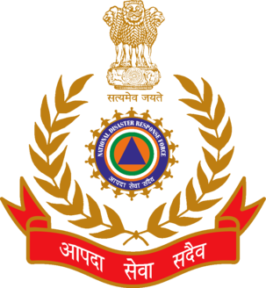
National Disaster Response Force (NDRF)
For the purpose of specialised response to a threatening disaster situation or disasters/emergencies both natural and man-made such as those of Chemical, Biological, Radiological and Nuclear origin, the Act has mandated the constitution of a National Disaster Response Force (NDRF).
The general superintendence, direction and control of this force shall be vested in and exercised by the NDMA and the command and supervision of the Force shall vest in an officer to be appointed by the Central Government as the Director General of Civil Defence and National Disaster Response Force

Slide 26
The Disaster Management Act has statutory provisions for constitution of National Disaster Response Force (NDRF) for the purpose of specialized response to natural and man-made disasters. Accordingly, in 2006 NDRF was constituted with 8 Battalions.
NDRF units will maintain close liaison with the designated State Governments and will be available to them in the event of any serious threatening disaster situation.
While the handling of natural disasters rests with all the NDRF battalions, four battalions will also be equipped and trained to respond to situations arising out of Chemical, Biological, Radiological and Nuclear emergencies.

Slide 27
Training centres will be set up by respective para-military forces to train personnel from NDRF battalions of respective Forces and will also meet the training requirement of State/UT Disaster Response Forces
The NDRF units will also impart basic training to all the stakeholders identified by the State Governments in their respective locations

Slide 28
At present, National Disaster Response Force consist of 15 battalions from the BSF, CISF, CRPF, ITBP, SSB and Assam Rifles. Each battalion have 18 self-contained specialist search and rescue teams of 45 personnel each including engineers, technicians, electricians, dog squads and medical/paramedics.
The total strength of each battalion is 1,149. All the 15 battalions have been equipped and trained to respond natural as well as man-made disasters.
Battalions are also trained and equipped for response during chemical, biological, radiological and nuclear (CBRN) emergencies.

Slide 29
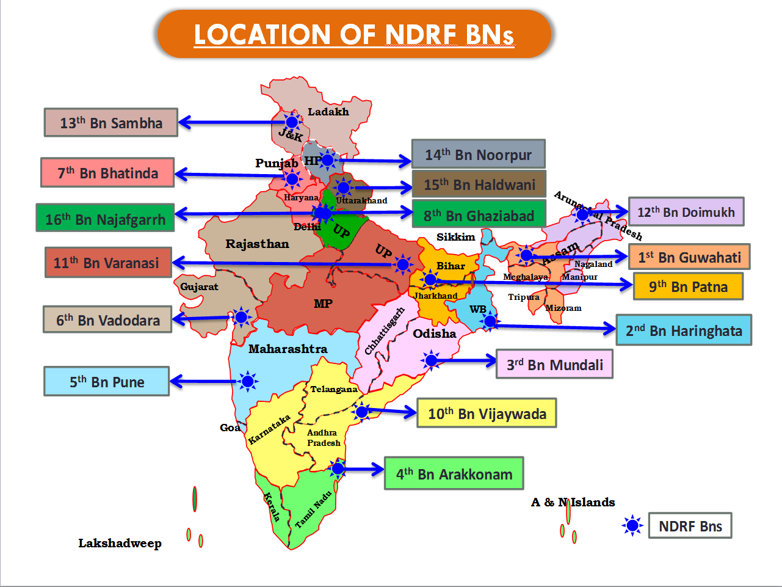

Slide 30
Other Important Institutional Arrangements
Armed Forces
Central Para Military Forces
State Police Forces and Fire Services
Civil Defense and Home Guards
State Disaster Response Force (SDRF)
Role of National Cadet Corps (NCC), National Service Scheme (NSS) and Nehru Yuva Kendra Sangathan (NYKS)

Slide 31
Sendai Framework for Disaster Risk Reduction 2015-2030
The Framework was adopted at the Third UN World Conference on Disaster Risk Reduction in Sendai, Japan, on March 18, 2015.
It aims to achieve the substantial reduction of disaster risk and losses in lives, livelihoods and health and in the economic, physical, social, cultural and environmental assets of persons, businesses, communities and countries over the next 15 years.

Slide 32
The seven global targets are:
Substantially reduce global disaster mortality by 2030, aiming to lower the average per 100,000 global mortality rate in the decade 2020–2030 compared to the period 2005– 2015
Substantially reduce the number of affected people globally by 2030, aiming to lower the average global figure per 100,000 in the decade 2020–2030 compared to the period 2005–2015
Reduce direct disaster economic loss in relation to global gross domestic product (GDP) by 2030
Substantially reduce disaster damage to critical infrastructure and disruption of basic services, among them health and educational facilities, including through developing their resilience by 2030

Slide 33
5. Substantially increase the number of countries with national and local disaster risk reduction strategies by 2020
6. Substantially enhance international cooperation to developing countries through adequate and sustainable support to complement their national actions for implementation of the present Framework by 2030
7. Substantially increase the availability of and access to multi-hazard early warning systems and disaster risk information and assessments to people by 2030

Slide 34
Priorities for action
1: Understanding disaster risk.
2: Strengthening disaster risk governance to manage disaster risk.
3: Investing in disaster risk reduction for resilience.
4: Enhancing disaster preparedness for effective response and to “Build Back Better” in recovery, rehabilitation and reconstruction.

Slide 35
1: Understanding disaster risk
Policies and practices for disaster risk management should be based on an understanding of disaster risk in all its dimensions of vulnerability, capacity, exposure of persons and assets, hazard characteristics and the environment.
Such knowledge can be leveraged for the purpose of pre-disaster risk assessment, for prevention and mitigation and for the development and implementation of appropriate preparedness and effective response to disasters.

Slide 36
Priority 2: Strengthening disaster risk governance to manage disaster risk
Disaster risk governance at the national, regional and global levels is of great importance for an effective and efficient management of disaster risk.
Clear vision, plans, competence, guidance and coordination within and across sectors, as well as participation of relevant stakeholders, are needed.
Strengthening disaster risk governance for prevention, mitigation, preparedness, response, recovery and rehabilitation is therefore necessary and fosters collaboration and partnership across mechanisms and institutions for the implementation of instruments relevant to disaster risk reduction and sustainable development.

Slide 37
Priority 3: Investing in disaster risk reduction for resilience
Public and private investment in disaster risk prevention and reduction through structural and non-structural measures are essential to enhance the economic, social, health and cultural resilience of persons, communities, countries and their assets, as well as the environment.
These can be drivers of innovation, growth and job creation. Such measures are cost -effective and instrumental to save lives, prevent and reduce losses and ensure effective recovery and rehabilitation.

Slide 38
Priority 4: Enhancing disaster preparedness for effective response and to "Build Back Better" in recovery, rehabilitation and reconstruction
The steady growth of disaster risk, including the increase of people and assets exposure, combined with the lessons learned from past disasters, indicates the need to further strengthen disaster preparedness for response, take action in anticipation of events, integrate disaster risk reduction in response preparedness and ensure that capacities are in place for effective response and recovery at all levels.
Empowering women and persons with disabilities to publicly lead and promote gender equitable and universally accessible response, recovery, rehabilitation and reconstruction approaches is key.

Slide 39
Disasters have demonstrated that the recovery, rehabilitation and reconstruction phase, which needs to be prepared ahead of a disaster, is a critical opportunity to "Build Back Better'; including through integrating disaster risk reduction into development measures, making nations and communities resilient to disasters.

Slide 40
Guiding principles
1. Each State has the primary responsibility to prevent and reduce disaster risk, including through international, regional, subregional, transboundary and bilateral cooperation.
2. Disaster risk reduction requires that responsibilities be shared by central Governments and relevant national authorities, sectors and stakeholders, as appropriate to their national circumstances and systems of governance
3. Managing the risk of disasters is aimed at protecting persons and their property, health, livelihoods and productive assets, as well as cultural and environmental assets, while promoting and protecting all human rights, including the right to development

Slide 41
4. Disaster risk reduction requires an all-of-society engagement and partnership. It also requires empowerment and inclusive, accessible and non discriminatory participation, paying special attention to people disproportionately affected by disasters, especially the poorest.
A gender, age, disability and cultural perspective should be integrated in all policies and practices, and women and youth leadership should be promoted.
In this context, special attention should be paid to the improvement of organized voluntary work of citizens.

Slide 42
5. Disaster risk reduction and management depends on coordination mechanisms within and across sectors and with relevant stakeholders at all levels, and it requires the full engagement of all State institutions of an executive and legislative nature at national and local levels and a clear articulation of responsibilities across public and private stakeholders, including business and academia, to ensure mutual outreach, partnership, complementarity in roles and accountability and follow-up.
6. While the enabling, guiding and coordinating role of national and federal State Governments remain essential, it is necessary to empower local authorities and local communities to reduce disaster risk, including through resources, incentives and decision-making responsibilities, as appropriate.

Slide 43
7.Disaster risk reduction requires a multi-hazard approach and inclusive risk-informed decision-making based on the open exchange and dissemination of disaggregated data, including by sex, age and disability, as well as on easily accessible, up-to-date, comprehensible, science-based, non-sensitive risk information, complemented by traditional knowledge.
8. The development, strengthening and implementation of relevant policies, plans, practices and mechanisms need to aim at coherence, as appropriate, across sustainable development and growth, food security, health and safety, climate change and variability, environmental management and disaster risk reduction agendas. Disaster risk reduction is essential to achieve sustainable development;

Slide 44
9. While the drivers of disaster risk may be local, national, regional or global in scope, disaster risks have local and specific characteristics that must be understood for the determination of measures to reduce disaster risk.
10.Addressing underlying disaster risk factors through disaster risk-informed public and private investments is more cost-effective than primary reliance on post-disaster response and recovery, and contributes to sustainable development

Slide 45
11.In the post-disaster recovery, rehabilitation and reconstruction phase, it is critical to prevent the creation of and to reduce disaster risk by “Building Back Better” and increasing public education and awareness of disaster risk
12. An effective and meaningful global partnership and the further strengthening of international cooperation, including the fulfilment of respective commitments of official development assistance by developed countries, are essential for effective disaster risk management

Slide 46
13. Developing countries, in particular the least developed countries, small island developing States, landlocked developing countries and African countries, as well as middle-income and other countries facing specific disaster risk challenges, need adequate, sustainable and timely provision of support, including through finance, technology transfer and capacity building from developed countries and partners tailored to their needs and priorities, as identified by them.

